Slide 1
Dynamic Memory Allocation

Slide 2
Allocation of Memory
Static Allocation: Allocation of memory space at compile time. Int a, float b;
Dynamic Allocation: Allocation of memory space at run time.

Slide 3
DMA
New : Memory allocation
Delete : Memory de-allocation

Slide 4


Slide 5


Slide 6


Slide 7
Dynamic Memory Allocation
Can allocate storage for a variable while program is running
Uses new operator to allocate memory
  int *ptr;
  ptr = new int ;
new returns address of memory location
10-<number>

Slide 8
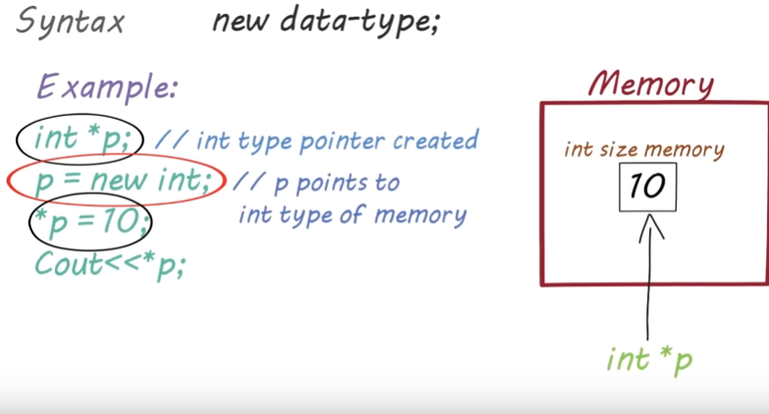

Slide 9
Dynamic Memory Allocation
Can also use new to allocate array
  arrayPtr = new int[25];
Can then use [ ] or pointer arithmetic to access array
10-<number>

Slide 10
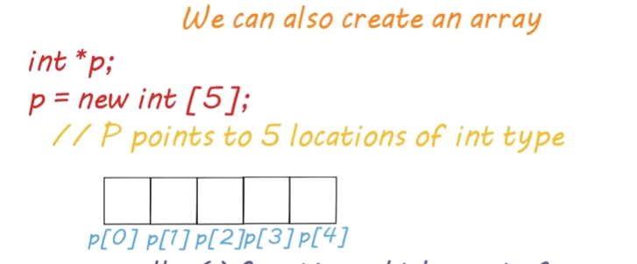

Slide 11
Releasing Dynamic Memory
Use delete to free dynamic memory
  delete dptr;
Use delete [] to free dynamic array memory
  delete [] arrayptr;
Only use delete with dynamic memory!
10-<number>
Notes:
See pr10-14.cpp

Slide 12
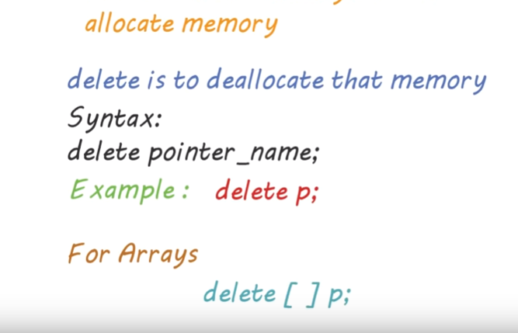

Slide 13
Example
int *ptr;
ptr = new int;
*ptr = 22;
cout << *ptr << endl;
delete ptr;
ptr = NULL;
ptr
FDE0
FDE1
FDE2
FDE3
0EC4
0EC5
0EC6
0EC7

Slide 14
Example (Cont ..)
int *ptr;
ptr = new int;
*ptr = 22;
cout << *ptr << endl;
delete ptr;
ptr = NULL;
ptr
FDE0
0EC4
FDE1
FDE2
FDE3
0EC4
0EC5
0EC6
0EC7

Slide 15
Example (Cont ..)
int *ptr;
ptr = new int;
*ptr = 22;
cout << *ptr << endl;
delete ptr;
ptr = NULL;
ptr
FDE0
0EC4
FDE1
FDE2
FDE3
0EC4
22
0EC5
0EC6
0EC7

Slide 16
Example (Cont ..)
int *ptr;
ptr = new int;
*ptr = 22;
cout << *ptr << endl;
delete ptr;
ptr = NULL;
ptr
FDE0
0EC4
FDE1
FDE2
FDE3
0EC4
22
Output:
22
0EC5
0EC6
0EC7

Slide 17
Example (Cont ..)
int *ptr;
ptr = new int;
*ptr = 22;
cout << *ptr << endl;
delete ptr;
ptr = NULL;
ptr
FDE0
?
FDE1
FDE2
FDE3
0EC4
0EC5
0EC6
0EC7

Slide 18
Example (Cont ..)
int *ptr;
ptr = new int;
*ptr = 22;
cout << *ptr << endl;
delete ptr;
ptr = NULL;
ptr
FDE0
0
FDE1
FDE2
FDE3
0EC4
0EC5
0EC6
0EC7

Slide 19
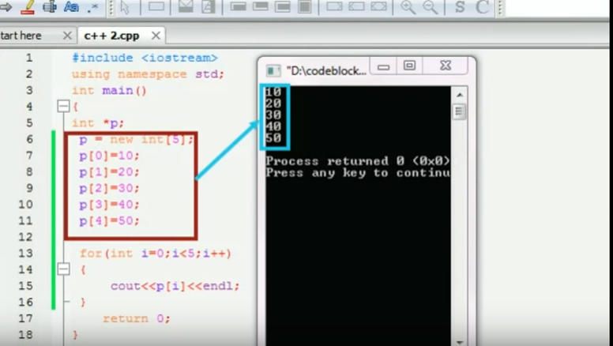

Slide 20
Memory leaks and
Dangling Pointers

Slide 21
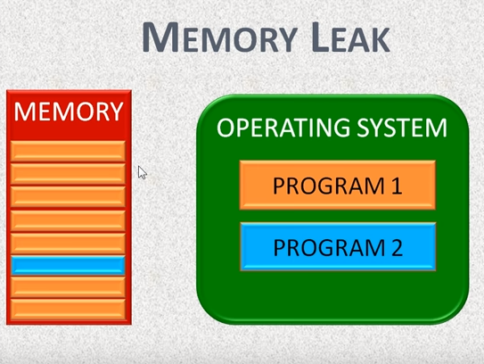

Slide 22
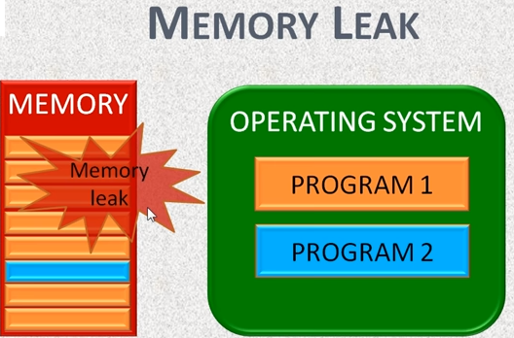
IF NO MEMORY IS RELAEASED AFTER COMPLETION

Slide 23
Memory leaks
Memory leak occurs, when a piece of memory which was previously allocated is not de-allocated properly by programmer. i.e delete operator is missing
Memory is no longer in use by the program and place is reserved for no reason. That’s why this is called the memory leak.
Example
void my_func()
{
int *data = new int;
*data = 50;
}

Slide 24
Memory leak example
ptr1
int *ptr1 = new int;
int *ptr2 = new int;
*ptr1 = 8;
*ptr2 = 5;
8
ptr2
5
ptr2 = ptr1;
ptr1
8
How to avoid?
ptr2
5

Slide 25
Inaccessible object
An inaccessible object is an unnamed object that was created by operator new and which a programmer has left without a pointer to it.
It is a logical error and causes memory leaks.

Slide 26
Dangling Pointer
It is a pointer that points to dynamic memory that has been deallocated.
The result of dereferencing a dangling pointer is unpredictable.

Slide 27
Dangling Pointer example
ptr1
int *ptr1 = new int;
int *ptr2;
*ptr1 = 8;
ptr2 = ptr1;
8
ptr2
delete ptr1;
ptr1
How to avoid?
ptr2

